Slide 1
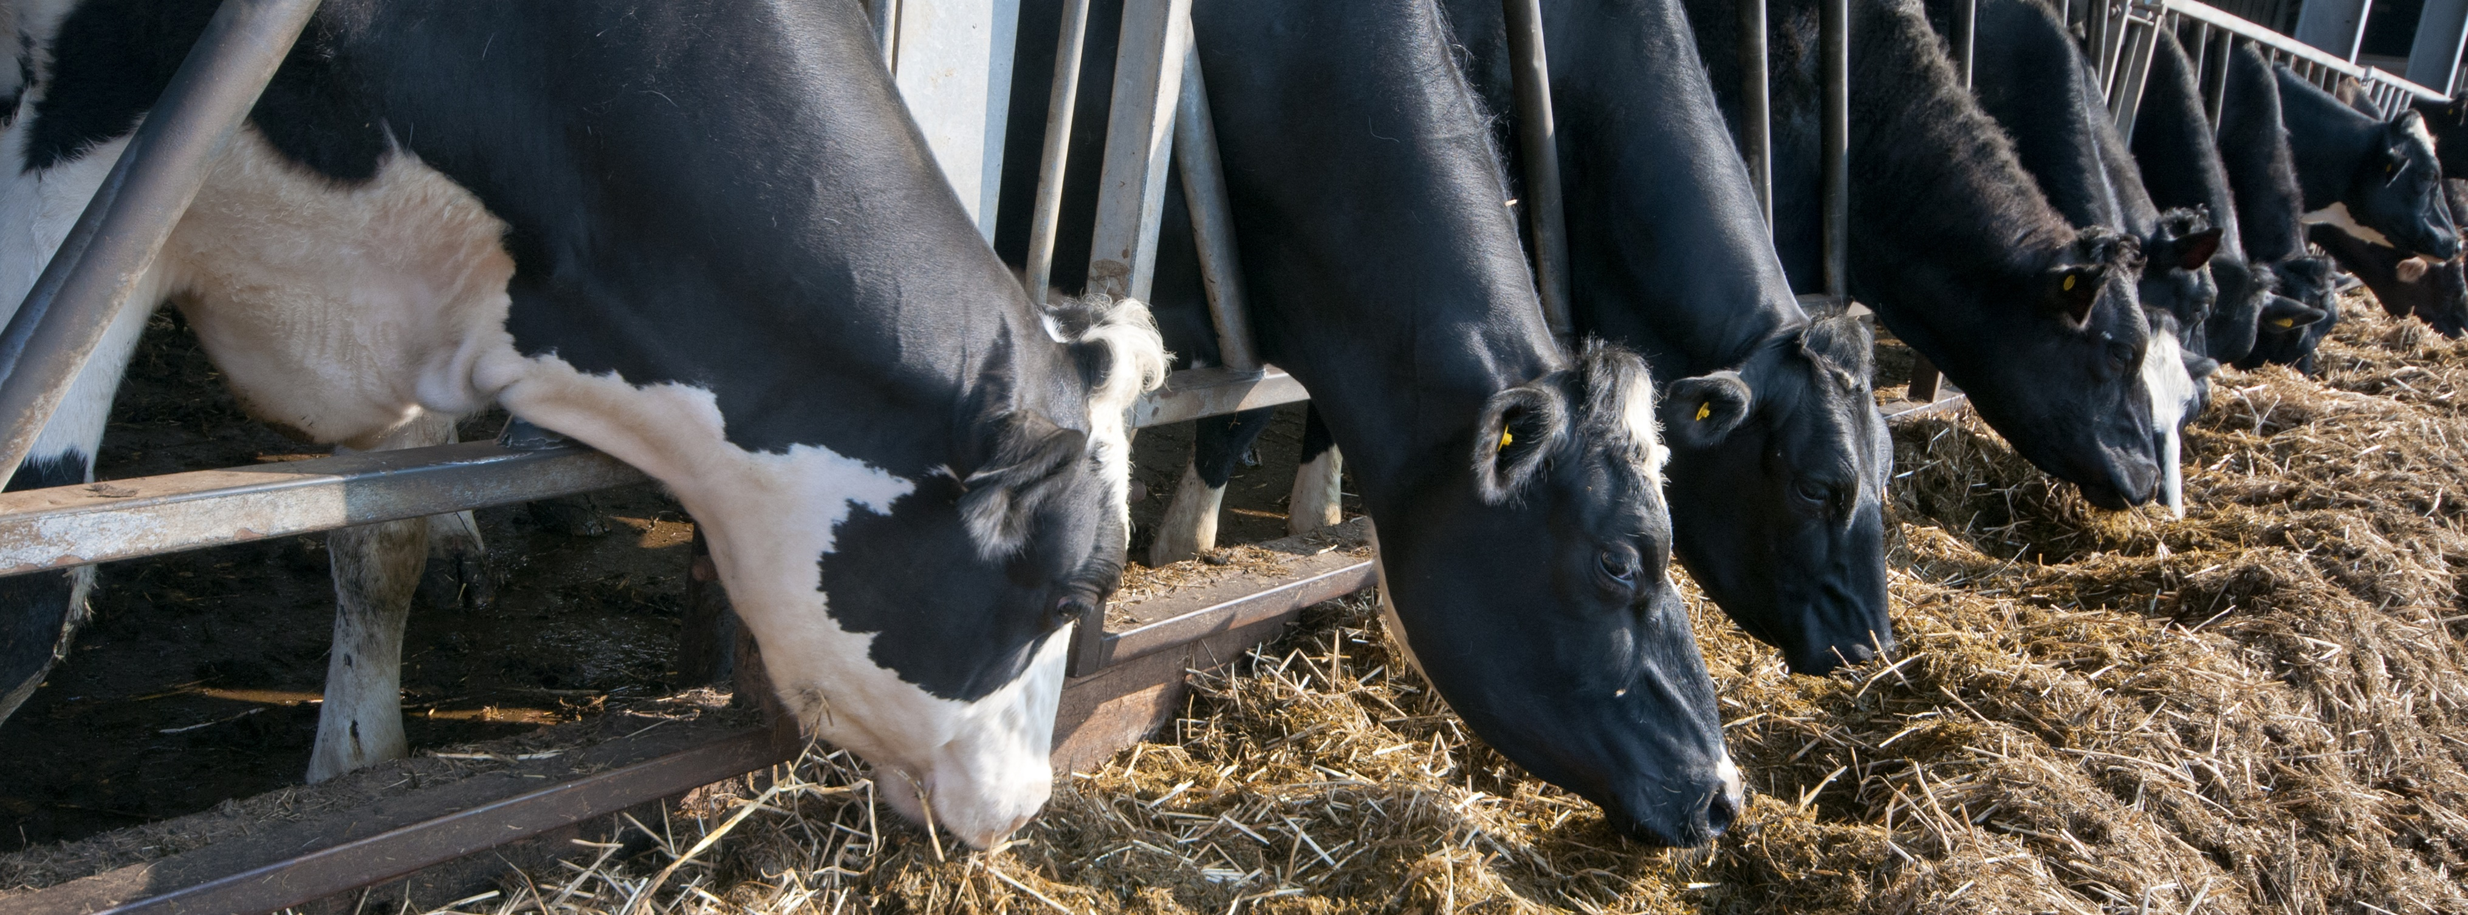
California Herd Analysis with OmniGen® Pro

Slide 2
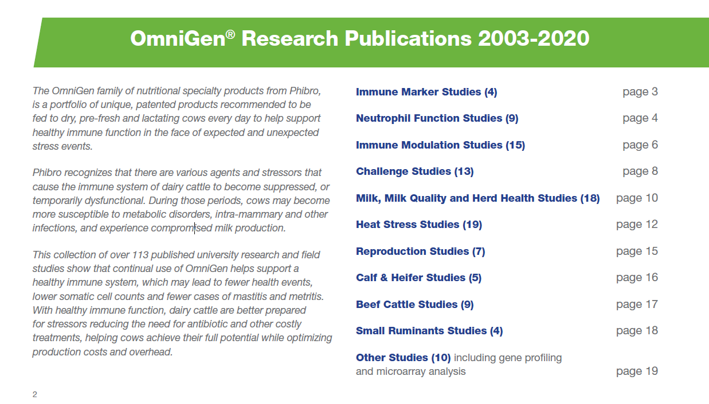
OmniGen Research
Close to 20 years of research and 100+ publications

Slide 3
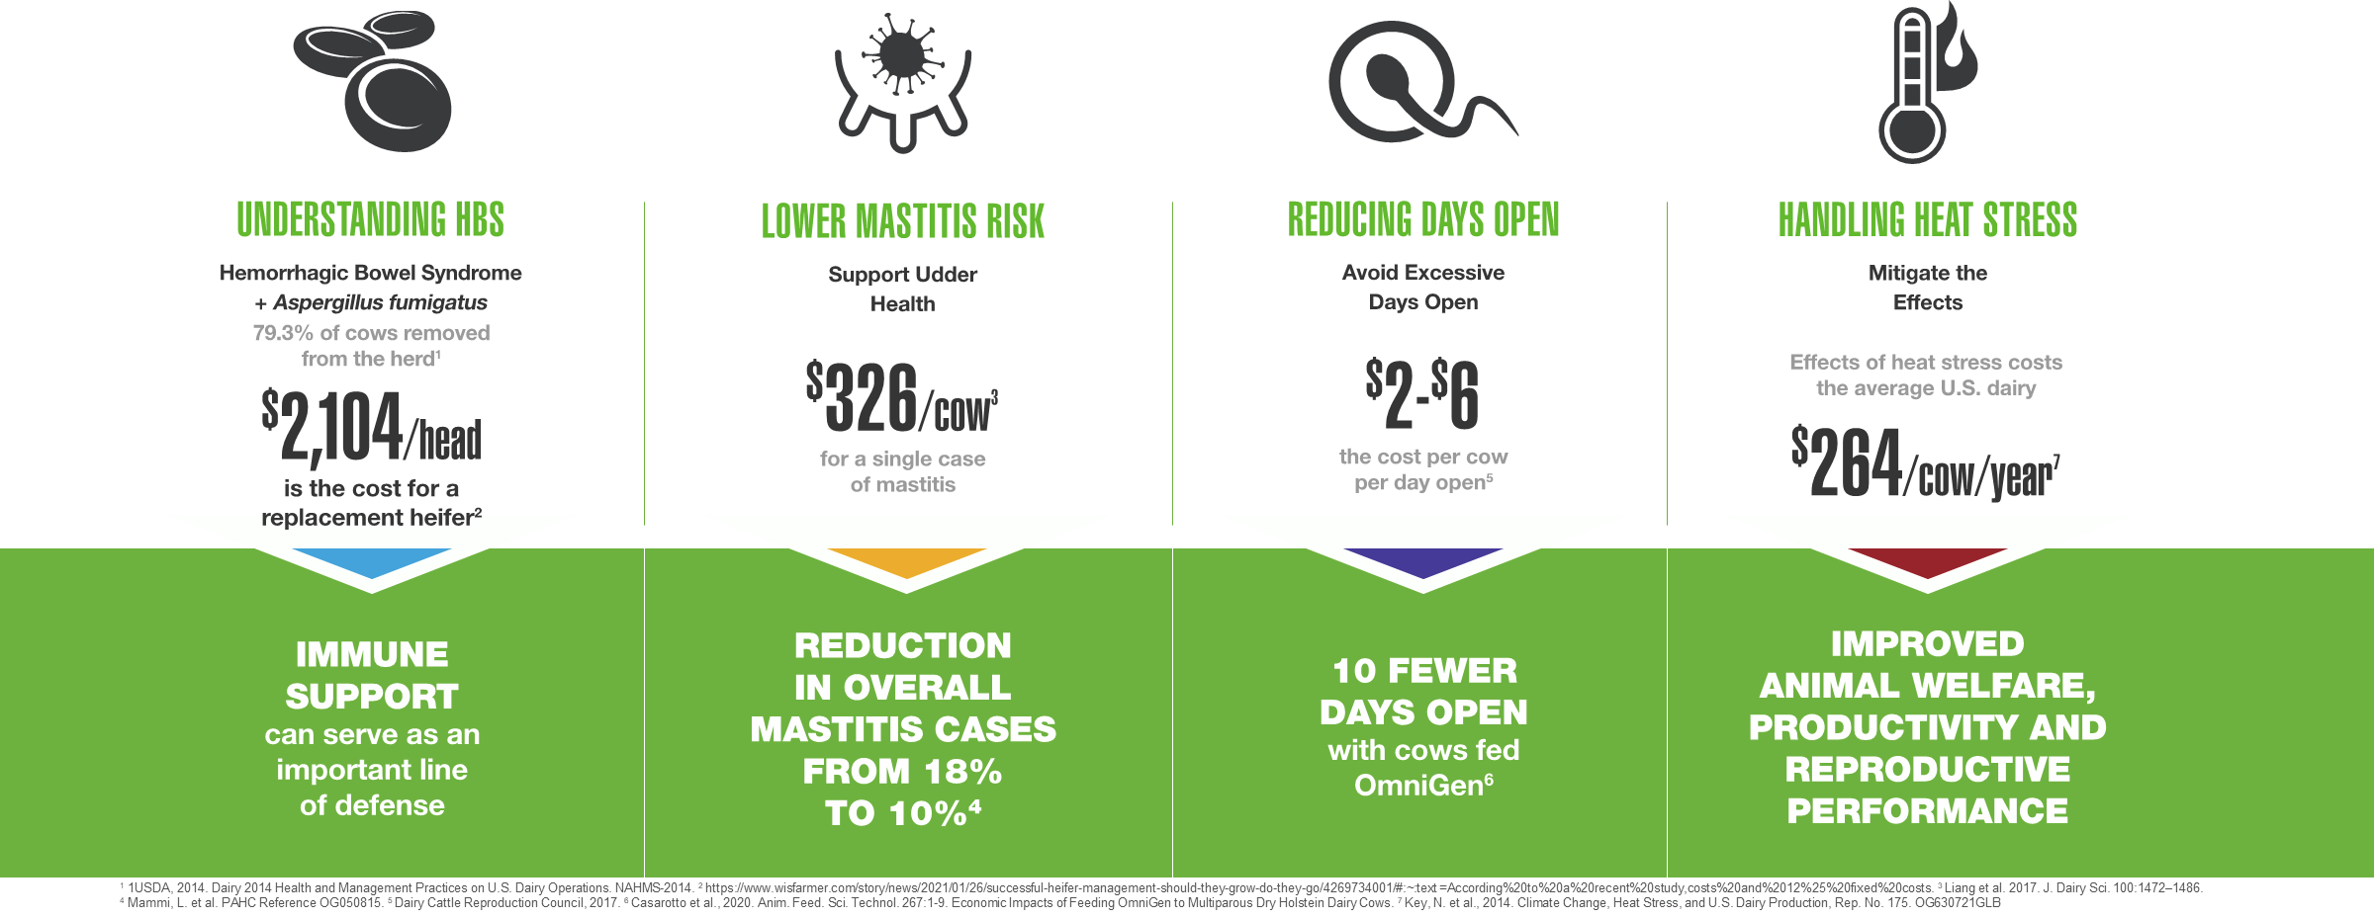
Four Ways to Protect Your Dairy Cows

Slide 4
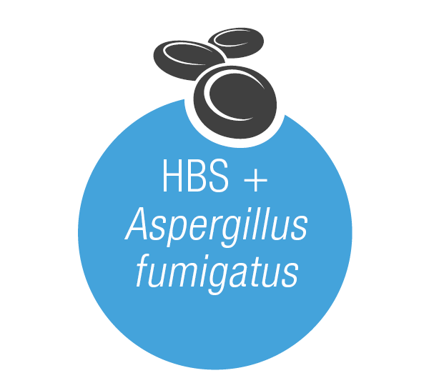

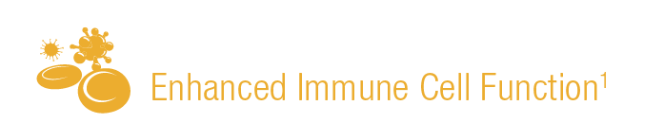
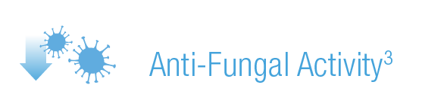


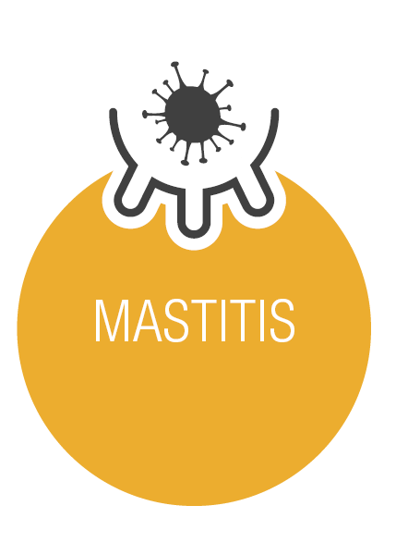

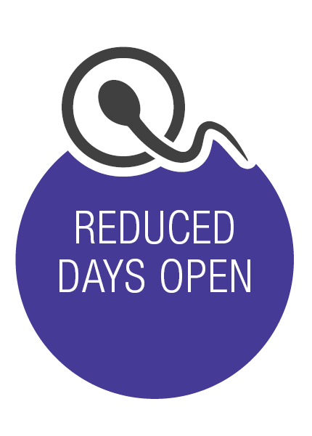




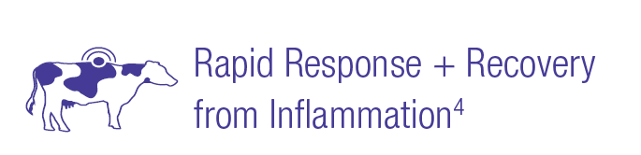
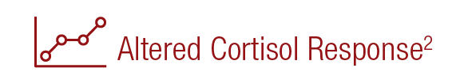
How OmniGen Delivers
¹Nace et al., 2014; Rowson et al., 2011; Ryman et al., 2013
³Puntenney et al., 2003; Chapman, 2007
²McBride et al., 2020
⁴Casarotto et al., 2020; Ribeiro et al., 2016

Slide 5


Mitigating heat stress during transition
Brandao et al., 2016. J. Dairy Science 99: 5562-5572
38 multiparous Holstein x Gir cows
  Control Treat
  OmniGen (56 g/cow)
Trial duration: -35 to 46 DIM

Slide 6


Mitigating heat stress during dry period
Fabris et al., 2017. J. Dairy Science 100: 1-10
University of Florida
64 Holsteins dairy cows
OmniGen supplementation: before, during, and after dry period (~ 160 days)
2 x 2 factorial
Diet: OG (56 g/day OG-AF) vs. CON (56 g/day AB20)
Environment dry-period: heat stress (HT) vs cooling (CL)
OmniGen
60 d to dry-off
45 d to calving
Calving
60 DIM
Control
Late Lactation
Dry Period
Early Lactation

Slide 7
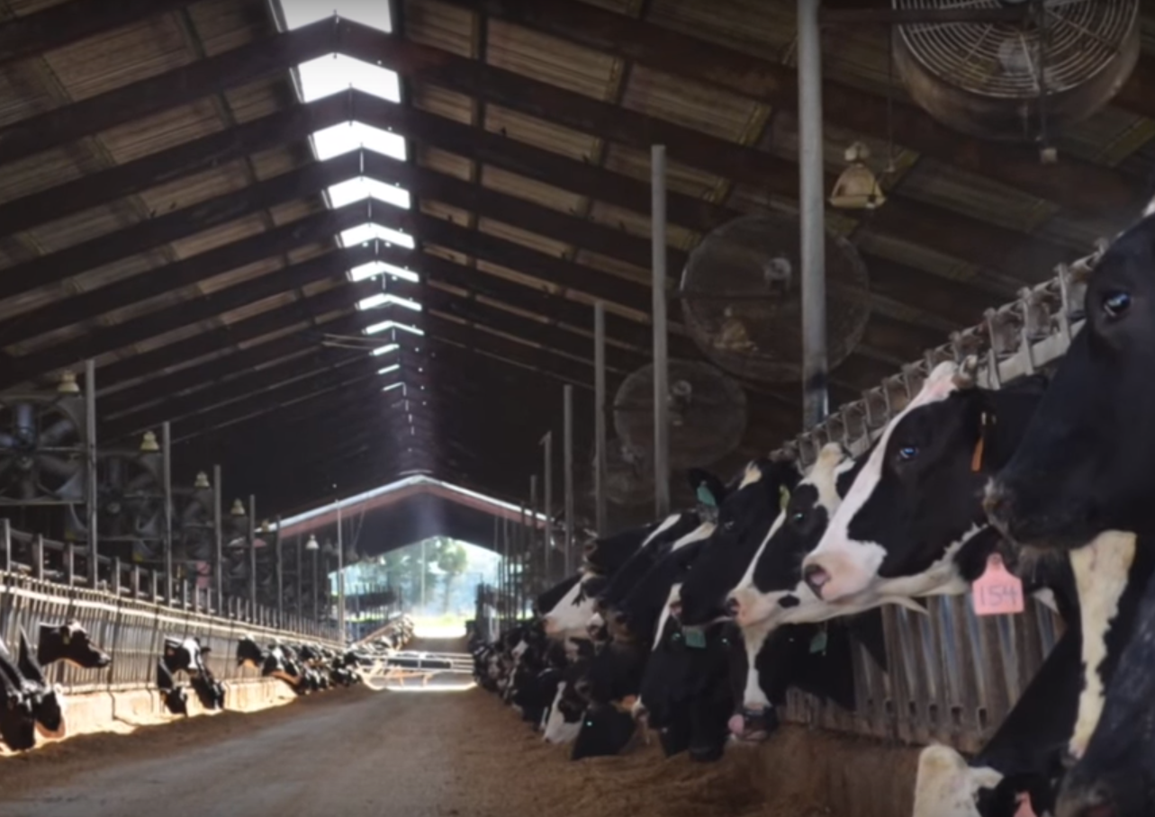
Improving Days Open
Casarotto et al., 2020. Animal Feed Sc. And Tech. 267: 114527
University of Florida / Large dairy herd study
1,465 multiparous Holsteins
Calved August 2018 – April 2019
Duration: 60 d before expected calving through 150 DIM (or confirmed pregnant)
Treatments
Placebo: 686 cows received AB20 (56g/day)
OmniGen-AF: 706 cows received OG-AF (56 g/day)
Notes:
This study was conducted by researchers at the University of Florida on a large commercial dairy near Gainesville, Florida.
<CLICK>
Nearly 1400 multiparous Holstein cows were randomly assigned to treatment at dry-off, approximately 60 days prior to expected calving. Dietary treatments were 56 g of OmniGen AF or 56 g of AB-20 (which was provided as a placebo control). In the white paper, and in this accompanying PowerPoint presentation, the OmniGen AF treatment will be abbreviated OG AF and the AB-20 treatment will be abbreviated CON.
<CLICK>
Treatment diets were fed from dry-off through confirmation of pregnancy or after the second synchronized breeding, at approximately 150 DIM.
<CLICK>
Animals received treatment diets for approximately 210 days in total.

Slide 8
Improving Days Open
Casarotto et al., 2020. Animal Feed Sc. And Tech. 267: 114527
OG AF
1st Service Conception Rate:
  OG AF = 32.6%
  CON = 28.1%
  P = 0.31
Days Open:
  OG AF = 139
  CON = 149
  P < 0.05
Notes:
This survival curve shows the percentage of cows that were not pregnant, shown on the Y-axis, during the 230 days after calving, shown on the X-axis. The survival curve includes results from all cows that calved during this study. Cows fed the AB-20 placebo control diet are represented by the gray dotted line, while cows fed OmniGen are represented by the blue dashed line. As expected, very few cows were pregnant prior to the voluntary waiting period of 77 DIM, since few cows were inseminated prior to that time. There is a sharp reduction in the percentage of cows not pregnant in the 7 days following the voluntary waiting period.
<CLICK>
It is at this point that an advantage for cows fed OmniGen appears.
<CLICK>
The graph reflects an improvement in the percentage of cows confirmed pregnant after first AI service, or first service conception rate, for cows fed OmniGen compared to cows fed the control diet. This difference was not statistically significant, however.
<CLICK>
Feeding OmniGen was associated with a 10-d reduction in days open, compared to feeding the AB-20 placebo. The Florida researchers suggest that the reduction in the days open among cows fed OmniGen may be related to the reduced incidence of diseases for this group. The University of Florida estimates an extra day open costs $3/day, so the enhanced reproductive performance associated with feeding OmniGen would lead to a savings of $30/cow, compared to feeding the control diet.

Slide 9
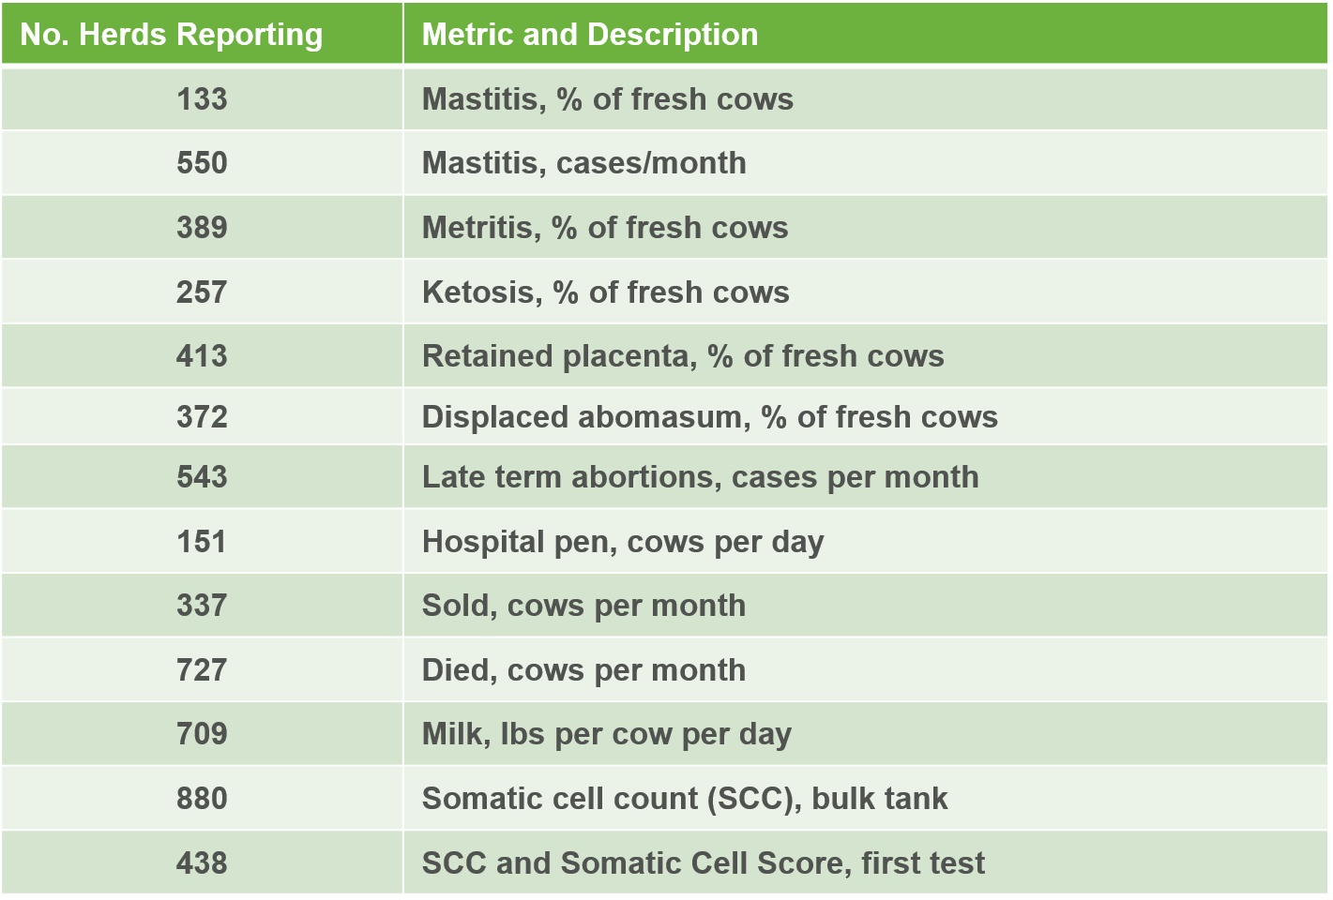
Immunity Challenge – field data
1,004 herds totaling 651,254 cows

Slide 10
Immunity Challenge – field data
1,004 herds totaling 651,254 cows

Slide 11
Immunity Challenge – field data
1,004 herds totaling 651,254 cows

Slide 12
Immunity Challenge – field data
1,004 herds totaling 651,254 cows
*
*
*
( ) = number of herds reporting data

Slide 13
2021 California Internship Project
Trt | Dairy | AFTMR* | AF Blood | Manure Score | Respiration
CTR | Farm A | 2,007 | 0.074 | 3.03 | 68.52
CTR | Farm B | 5,102 | 0.152 | 3.16 | 82.62
CTR | Farm C | 3,685 | 0.133 | 2.92 | 73.86
OG | Farm D | 992 | 0.027 | 3.05 | 63.66
OG | Farm E | 7,984 | 0.082 | 2.92 | 66.75
OG | Farm F | 337 | 0.069 | 2.95 | 62.46
Trt | AFTMR* | AF Blood | Manure Score | Respiration
CTR | 3,596 | 0.12 | 3.04 | 75.00
OG | 3,000 | 0.06 | 2.97 | 64.29
n | 96 | 288 | 1,500 + | 1,500 +
Units
AF TMR: spores/g
AF Blood: GU x 10⁴/ml
Manure Score: scale 1 – 5
Respiration: breaths per minute
*Two outliers for AF TMR removed:
CTR – Farm C: 187,492 spores/g
OG – Farm E: 620,574 spores/g
Confidential - Do not Distribute

Slide 14
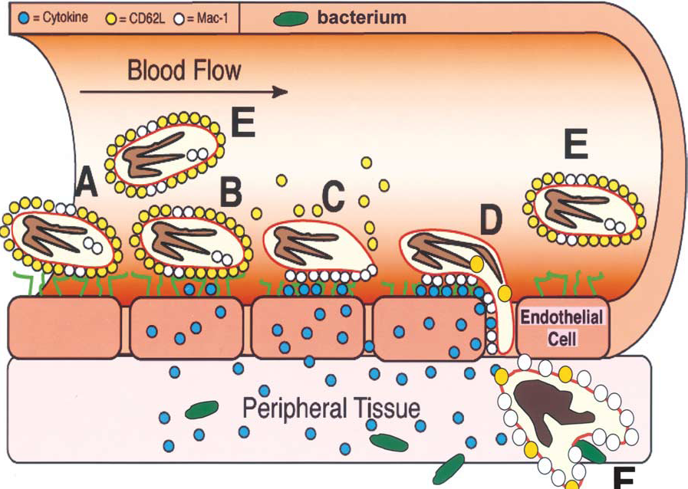
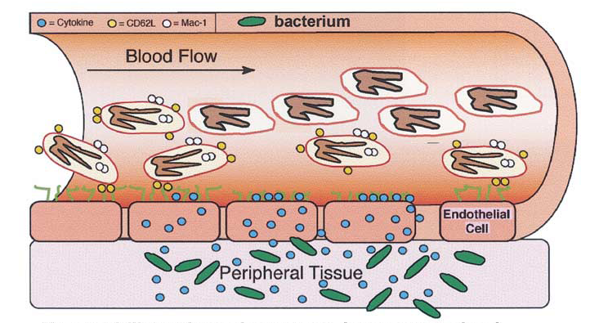

Effects of Stress on Immunity
Cortisol
Normal Immune function
Immunosuppression due to cortisol
Burton and Erskine, 2003

Slide 15
California Herd Analysis
Record analysis on 5 dairies from the Central Valley that tested OmniGen.
Data Includes:
Sold and died <60 DIM
Herd Health Events
Reproduction
Milk Production

Slide 16
California Herd Analysis
Dairy | # Cows | Location | Dairy Breed | Supplementation Period | Group of Cows Supplemented
1 | ~ 5,000 | South Valley | Holsteins | Nov – Mar | All
2 | ~2,500 | North Valley | Holsteins | Full year | Lactating
3 | ~1,000 | North Valley | Holsteins | Full year | All
4 | ~5,000 | South Valley | Holsteins | April - September | Lactating and close-up cows
5 | ~5,000 | North Valley | Holsteins/Jerseys | Full year | All

Slide 17
California Herd Analysis – Sold & Dead (DIM < 60)
Dairy 1 has not been analyzed yet

Slide 18
California Herd Analysis – Dead
All cows as a % of the herd

Slide 19
California Herd Analysis – Mastitis

Slide 20
California Herd Analysis – SCC
Dairies 1, 3 and 4 did not do monthly DHIA component testing

Slide 21
California Herd Analysis – Aborts
Dairy 3 has not been analyzed yet

Slide 22
California Herd Analysis – Lame
Dairy 1 has not been analyzed yet

Slide 23
California Herd Analysis – Reproduction
VWP = 58
VWP = 50
Dairy 1 was not on OmniGen long enough to analyze
Dairy 3 has not been analyzed yet

Slide 24
California Herd Analysis – Overall Milk
Overall Gain
+ 3.0 lbs/days
Jersey Cows

Slide 25
California Herd Analysis – Summer Milk
Overall Gain
+ 3.5 lbs/days
Dairy 1 did not feed during summer months
Dairy 3 does not have consistent DHIA testing
Jersey Cows

Slide 26
California Herd Analysis – Startup Milk
Dairy 1
(non-OG: ave. of before and after)
Dairy 2
Dairy 4

Slide 27
Dairy #1
~5,000 cows
South Valley

Slide 28
Health Events
Dairy #1

Slide 29
Mastitis Tubes to Cow Ratio
With and Without OmniGen Pro Dairy #1

Slide 30
Milk Production
Dairy #1

Slide 31
Week Milk all Lactating Cows
Dairy #1

Slide 32
Late Term Aborts >180 DCC
Dairy #1

Slide 33
Dairy #2
~2,500 cows
North Valley

Slide 34
Overall Health Events
Dairy #2

Slide 35
Milk Production year over year
Dairy #2

Slide 36
Start-up Milk Production
Dairy #2

Slide 37
SCC
Dairy #2

Slide 38
Repro
Dairy #2

Slide 39
Dairy #3
About 1,000 cows
North Valley

Slide 40
Herd Health Events
Dairy #3

Slide 41
Fresh Cow Health Events
Dairy #3

Slide 42
Overall Milk Production
Dairy #3

Slide 43
Dairy #4
~5,000 cows
South Valley
The herd had fed OmniGen in winter months for
several years and started feeding OmniGen Pro in summer
2021. Only summer months were evaluated in this analysis.

Slide 44
Fresh Cow Health
Dairy #4

Slide 45
Fresh Cow Health
Dairy #4

Slide 46
Overall Herd Health
Dairy #4

Slide 47
Reproduction
Dairy #4

Slide 48
Reproduction
Dairy #4

Slide 49
Reproduction
Dairy #4

Slide 50
Reproduction
Dairy #4

Slide 51
Start-up Milk Production 2+ Lact Cows
Dairy #4

Slide 52
Start-up Milk Production 1st Lact Cows
Dairy #4

Slide 53
Overall Milk Production 2+ Lact Cows
Dairy #4

Slide 54
Milk Production 1st Lact Cows
Dairy #4

Slide 55
Dairy #5
~5,000 cows
North Valley

Slide 56
Health Events All Cows
Dairy #5

Slide 57
Milk
Dairy #5

Slide 58
Repro
Dairy #5

